Slide 1


AN ANALYSIS OF
Presented by The Mousketeers:
Collin Crossland, Hal Marsh,
Katherine Morriss. & Gary Watts

Slide 2




WHAT IS THE LARGEST CONTRIBUTOR TO DISNEY’S REVENUE?
Major Categories
Disney Consumer Products
Disney Interactive
Walt Disney Parks & Resorts
Disney Media Networks

Slide 3

CROSSLAND ACADEMY
2016 National Exemplar
ABC - 1995
Pixar Animation Studios – 2006
Marvel Entertainment – 2009
Lucasfilm - 2012
21st Century Fox - 2017
MAJOR ACQUISTIONS

Slide 4
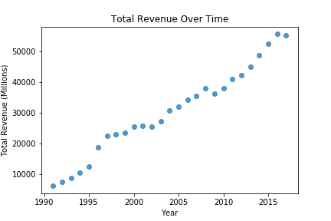
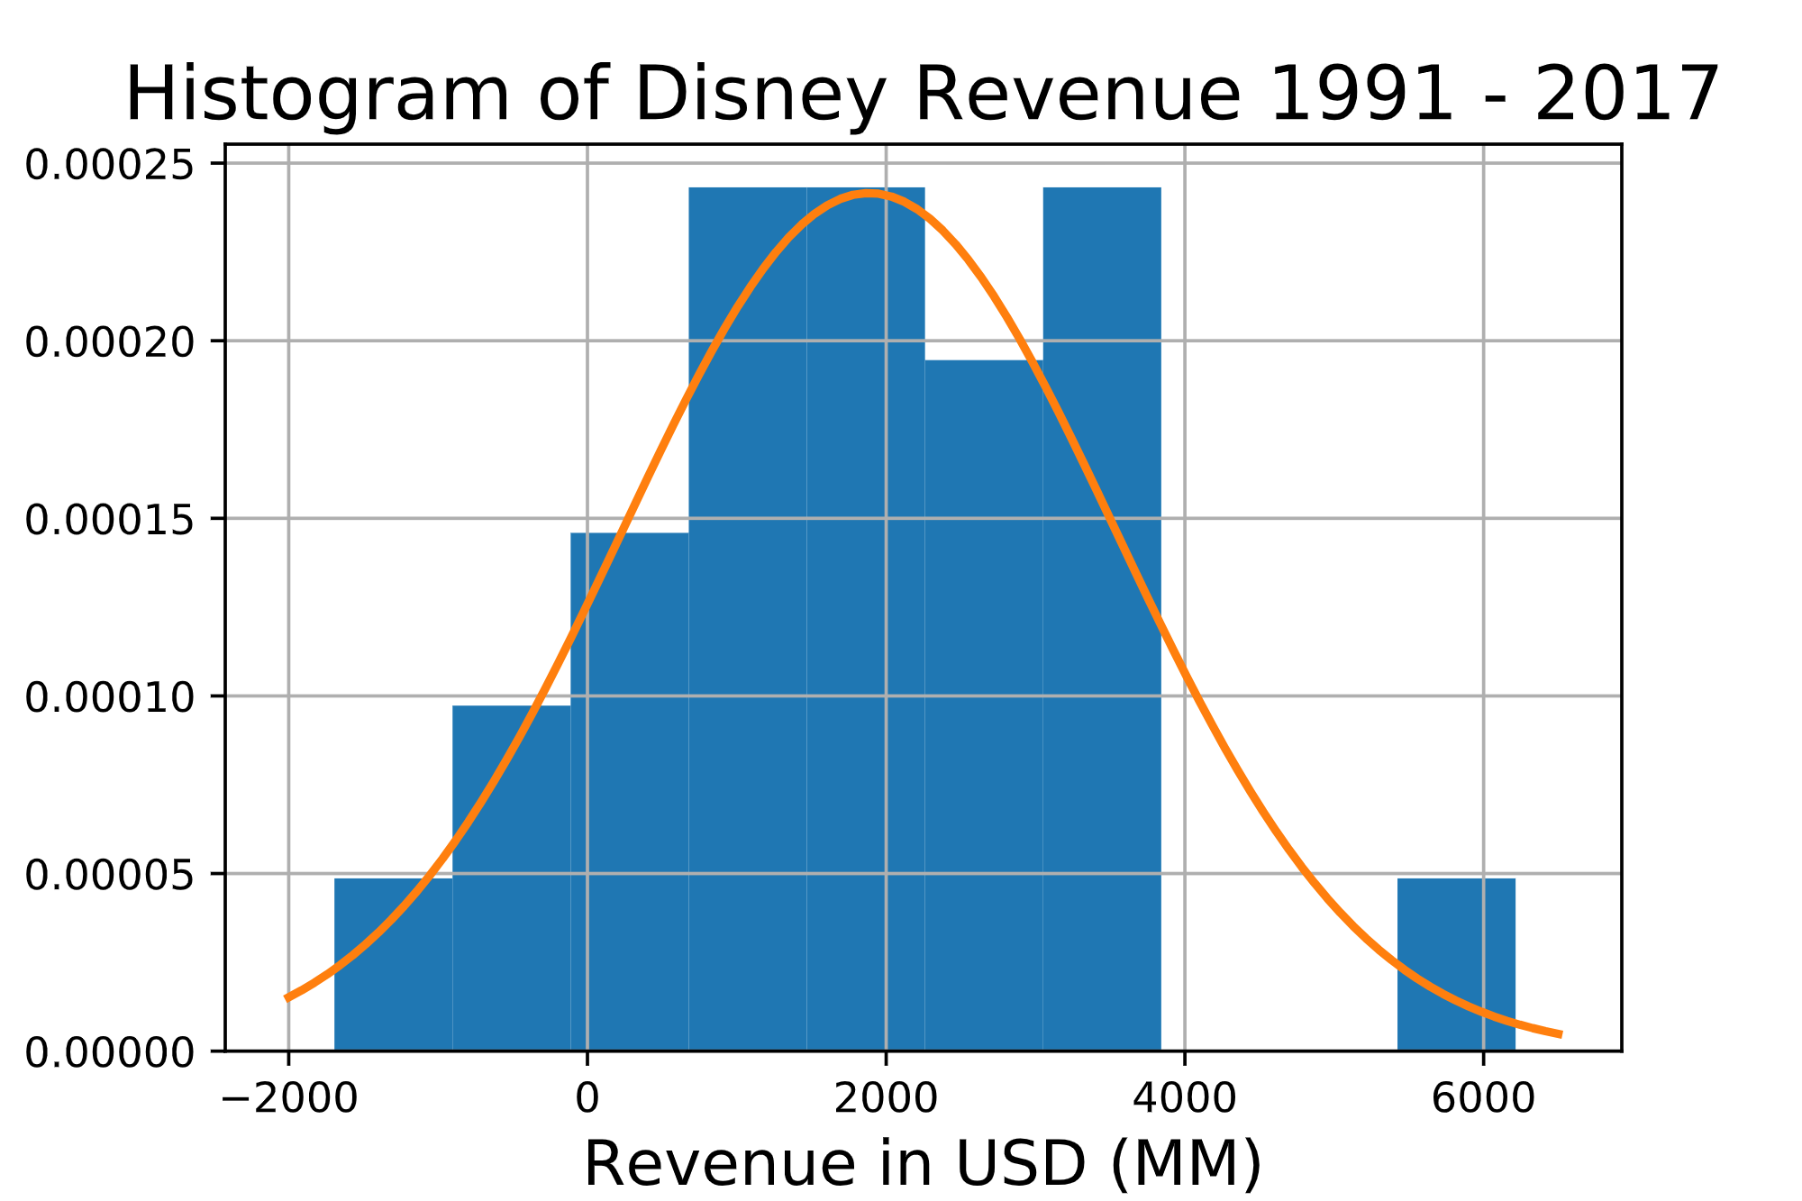
What trends are seen in Disney’s Revenue
Increase over time
Positive impact after each acquisition
Drop from 2016 to 2017
Large leap after ABC Acquisition

Slide 5
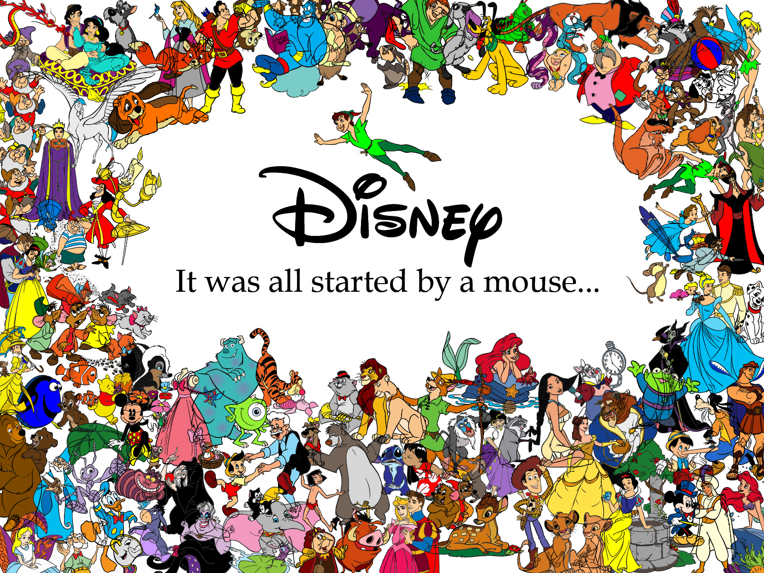
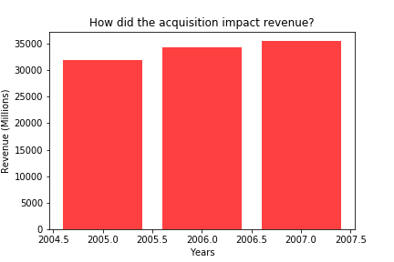
IMPACT FROM
ACQUISITIONS
Most of Disney’s acquisitions lead to an increase in revenue
Some of the acquisitions showed larger impact than other
Acquisition of ABC set Disney up to become major powerhouse in the media industry
Pixar already had a partnership with Disney, and had smaller impact after acquired (graphic below)

Slide 6
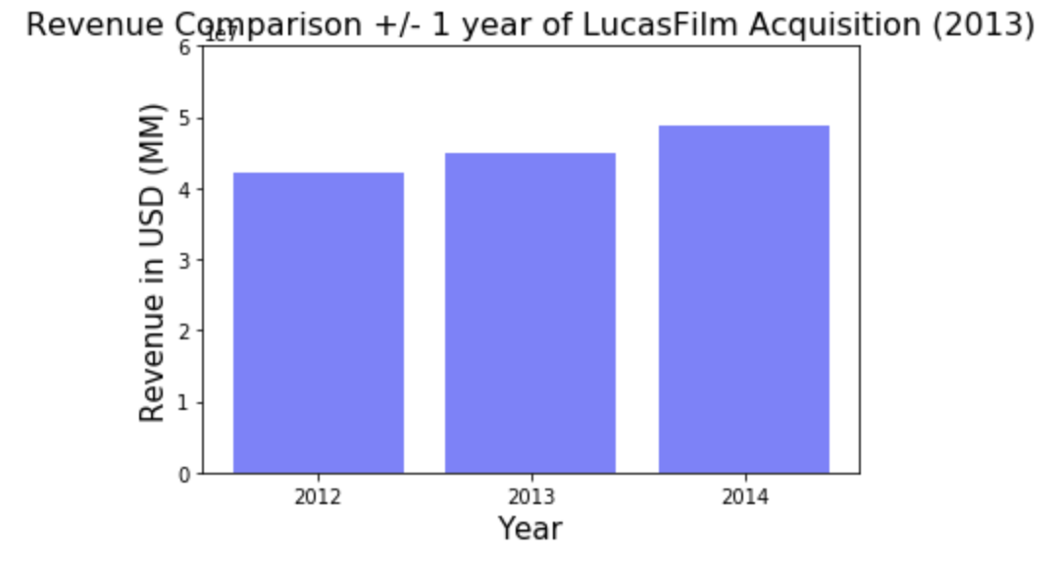
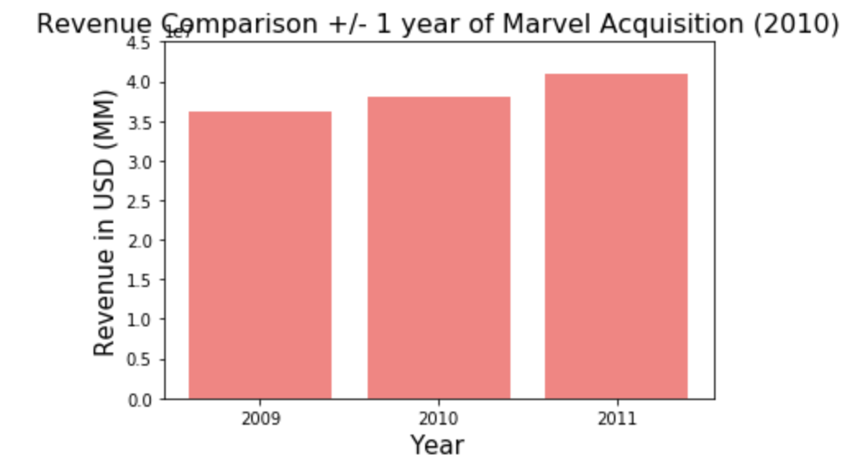
MARVEL VS LUCASFILMS
Recent acquisitions had a large presence in popular culture before being acquired, but did they have a large impact on revenue?

Slide 7

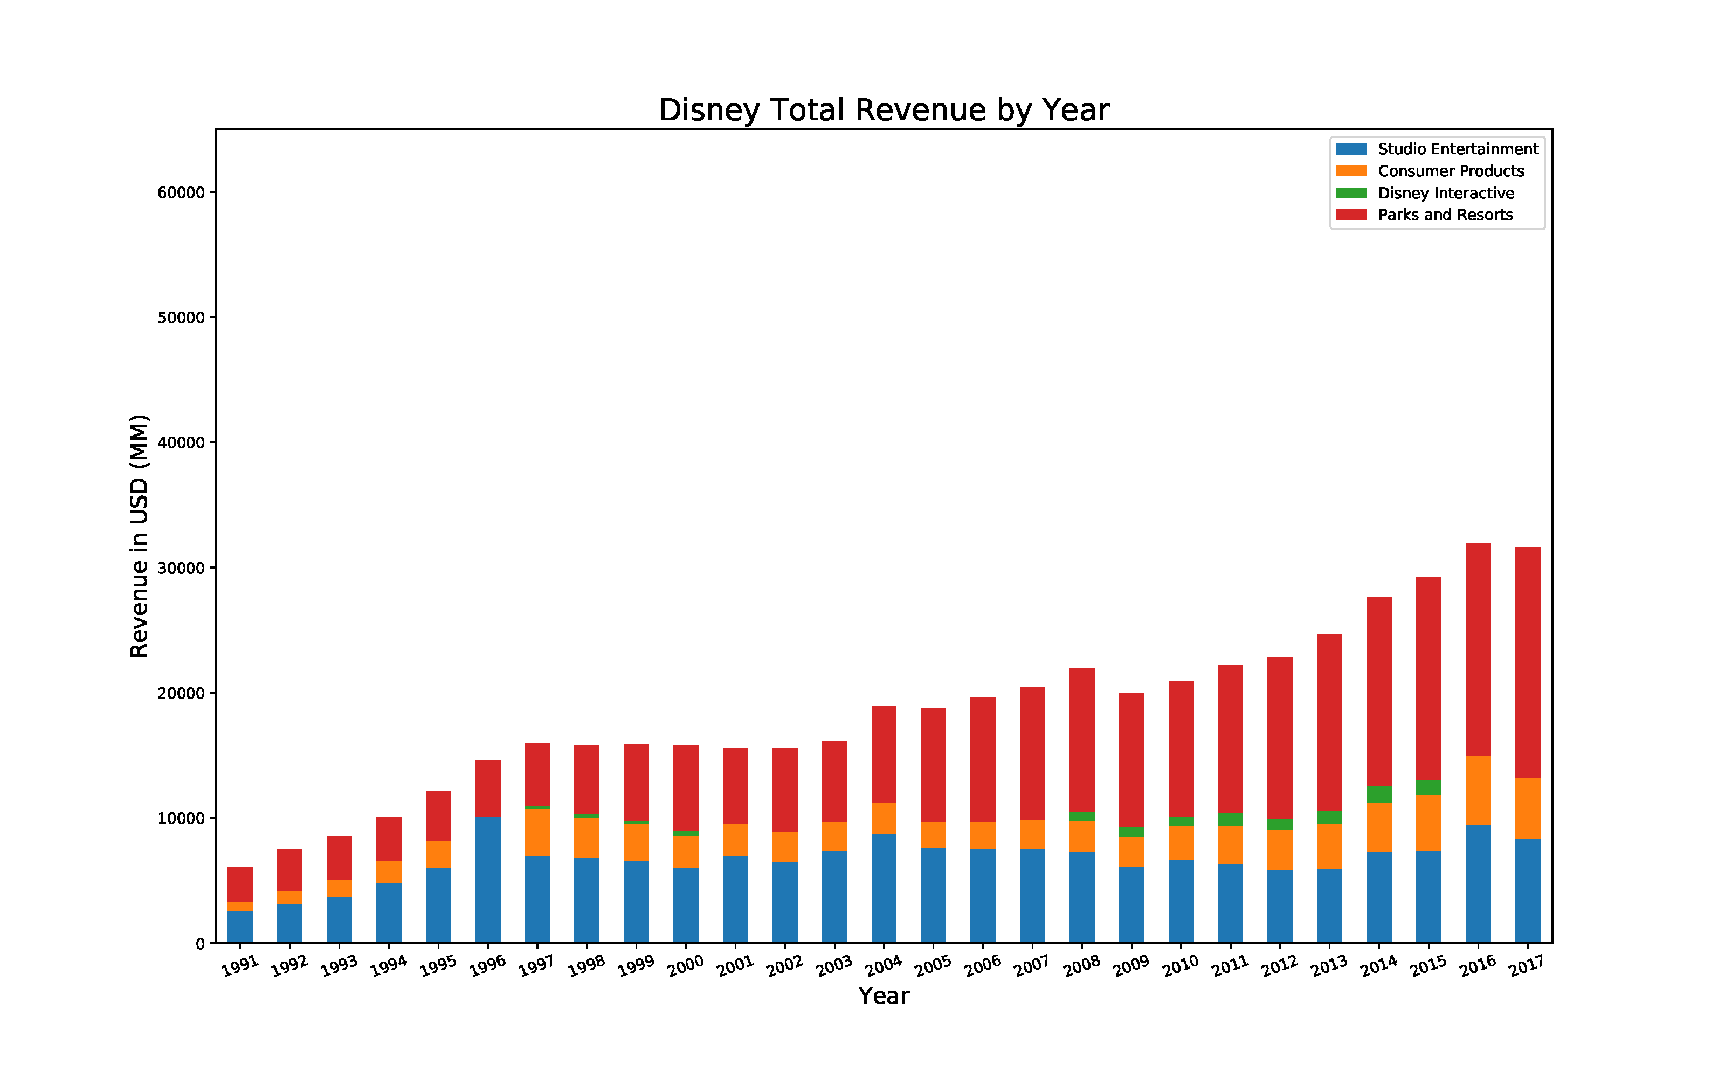
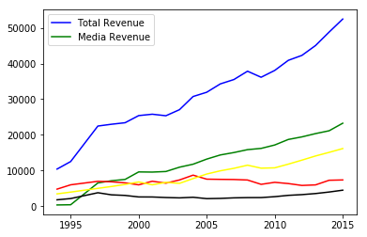
REVENUE

Slide 8


Slide 9

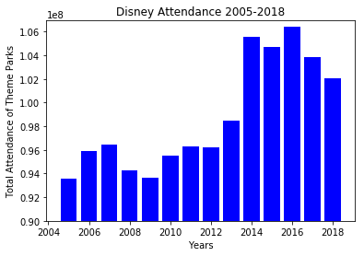
IS IT A SMALL WORLD AFTER ALL?
Data for Disney parks attendance indicates that it is not.

Slide 10

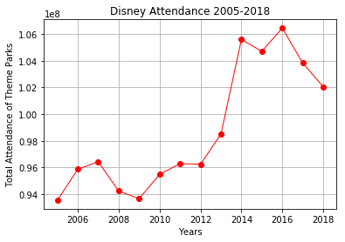
DISNEY PARKS CONTINUED

Slide 11
SUMMARY OF FINDINGS
When Disney has made an acquisition, the acquisition itself does not generally lead to an increase in revenue that would be considered statistically significant
What Disney adds to its parks and consumer products as a result of the acquisitions ends up driving revenue up
New movies, attractions and products take time to develop and produce
Therefore a change in revenue due to an acquisition is likely to be spread out over time (changes over several years as opposed to a statistically significant change the year following the acquisition) and likely overlap with changes in revenue from other acquisition
Furthermore, when an acquisition leads to new characters, storylines and film rights. Park attendance goes up and film revenue expands

Slide 12


THANK YOU!

